Slide 1
Pizza Sales Analysis Dashboard
File created on: 06/12/2023 01:54:18

Slide 2
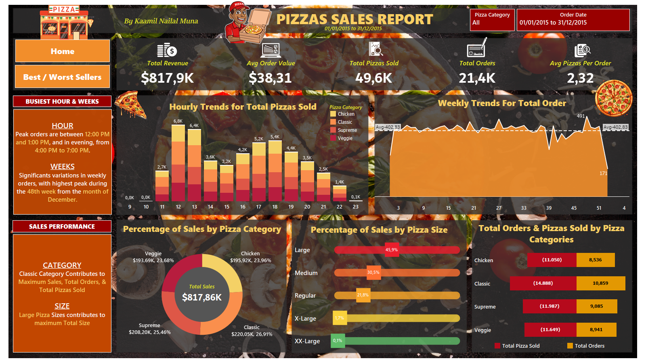

Slide 3
